Slide 1

WALL easy street Trading algorithm
Use signals and machine learning for profitable trading
April 2022

Slide 2
Team: Group 2
Kevin Gross
Ann Howell
Neil Mendelow
Angela Richter

Slide 3
Goal & Key Questions
Create a long-only algorithmic trading model that can correctly predict buying or selling entries/ exits from the S&P 500 and outperforms a buy and hold strategy
What technical indicators create the most consistent profit trading?
How can machine learning improve the models and which model is best?
Can an algorithm trained and tested on equities data be re-used for crypto data?
This type of analysis leverages machine learning models and thinking to implement a FinTech solution. The ability to predict and quickly respond to market changes could result in significant profit through buy and sell signals without the bias of human decision making.

Slide 4
Analysis Steps
Technical Indicators
Create baseline performance and generate trading signals using technical indicators
Machine Learning
Try to optimize technical indicators data using machine learning algorithms
Test with crypto
Apply an algorithm trained on SPY data to cryptocurrency trading
Try to optimize with a neural network model
MACD, RSI, Stochastic Double Cross, custom
Train-test the algorithm with 4 indicators
Back-tested
Data: Hourly SPY data pulled via API from Yahoo Finance to cover previous 252 trading days
Libraries: Python libraries include Scikit-Learn, Tensor Flow Keras, Pandas-ta, Yfinance

Slide 5
Algorithmic Trading with Technical Indicators
Trying to find a set if rules to tell the system when to buy or sell an asset and execute a trading strategy
MACD (moving average convergence/divergence ): a trading indicator that shows the relationship between two moving averages of a security's price; identify when bullish or bearish momentum is high in order to identify entry and exit points for trades
RSI (Relative Strength Index): charts the current and historical strength or weakness of a stock or market based on the closing prices of a recent trading period; measures the magnitude of recent price changes to analyze overbought or oversold conditions
Stochastic Double Cross: has two lines – an indicator line and a signal line; used to identify oversold and overbought conditions and spot divergences between the price and indicator; often paired with the MACD
Custom Indicator: Combined Stochastic and MACD

Slide 6
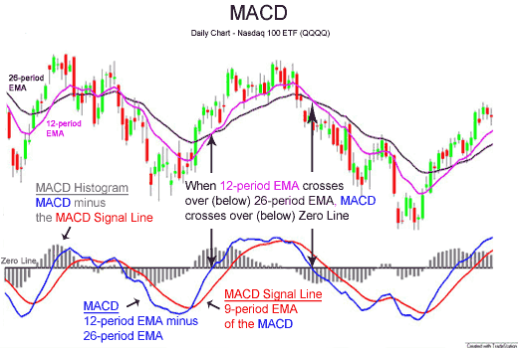
MACD Explanation
Source: Wikipedia

Slide 7
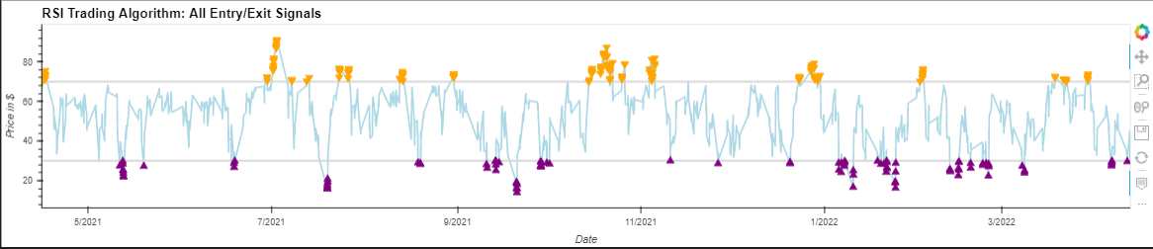
RSI Explanation

Slide 8
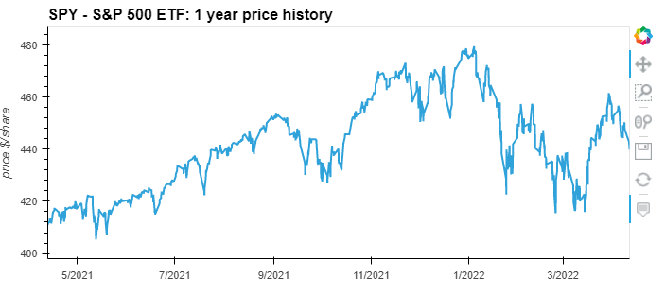
SPY Market Overview

Slide 9
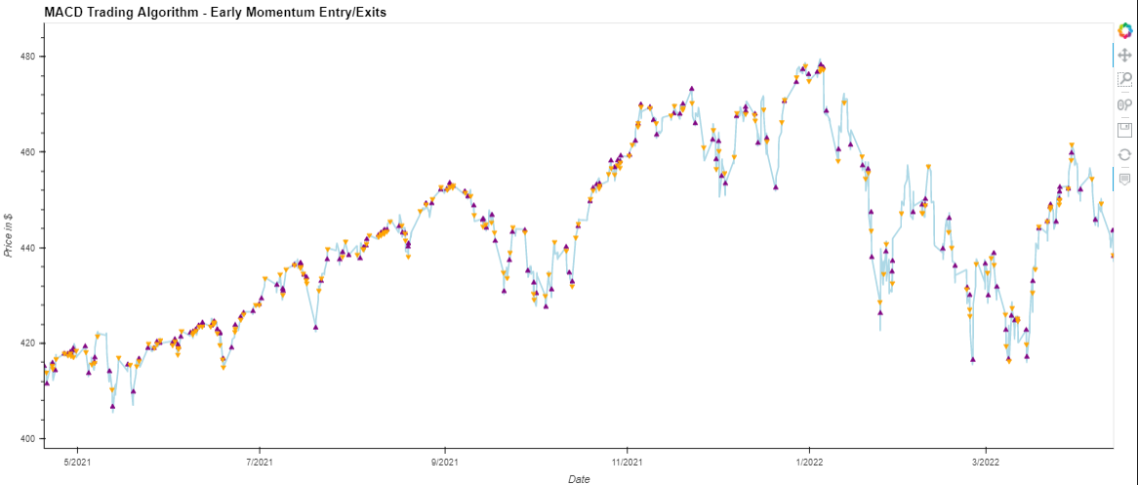
Technical Indicator Graphs – MACD 1

Slide 10
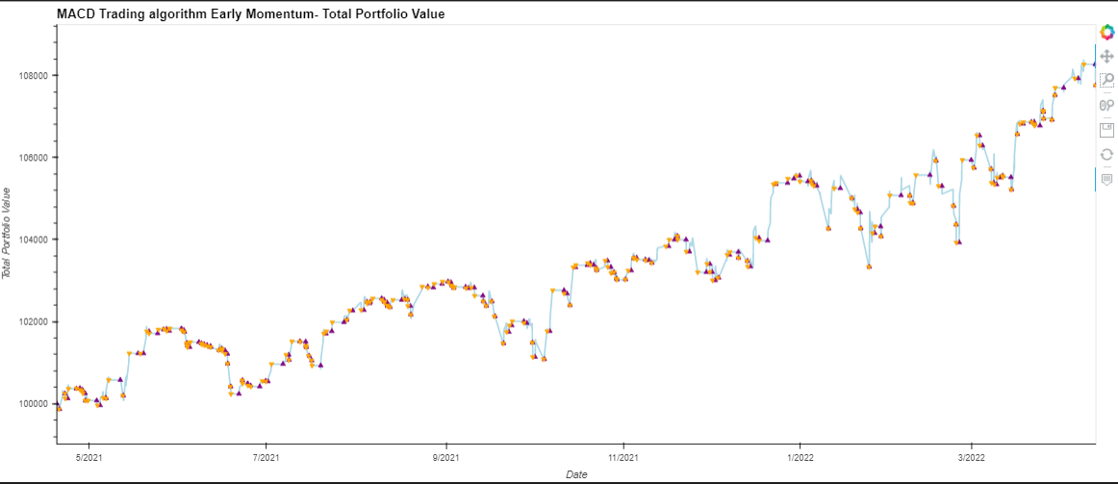
Technical Indicator Graphs – MACD 2

Slide 11
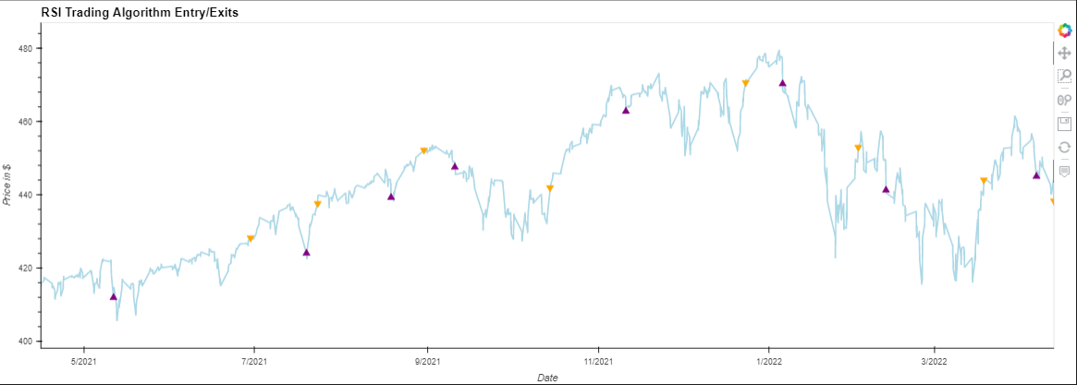
Technical Indicator Graphs - RSI

Slide 12
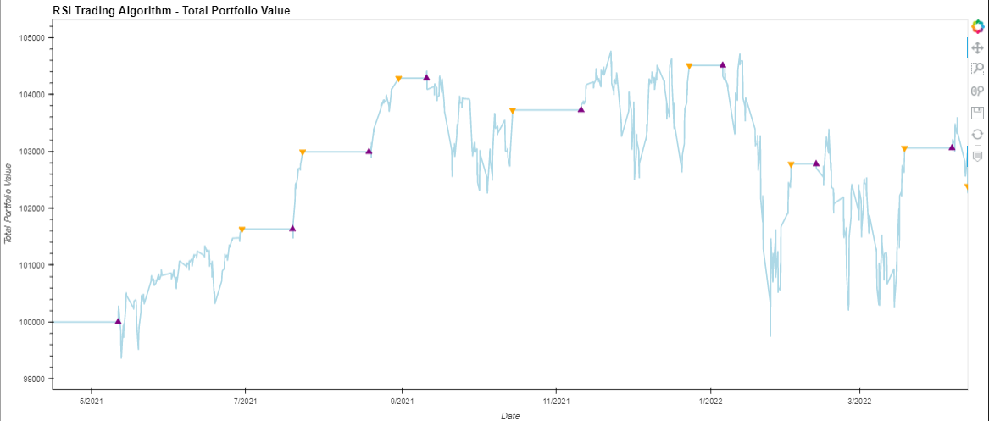
Technical Indicator Graphs - RSI

Slide 13
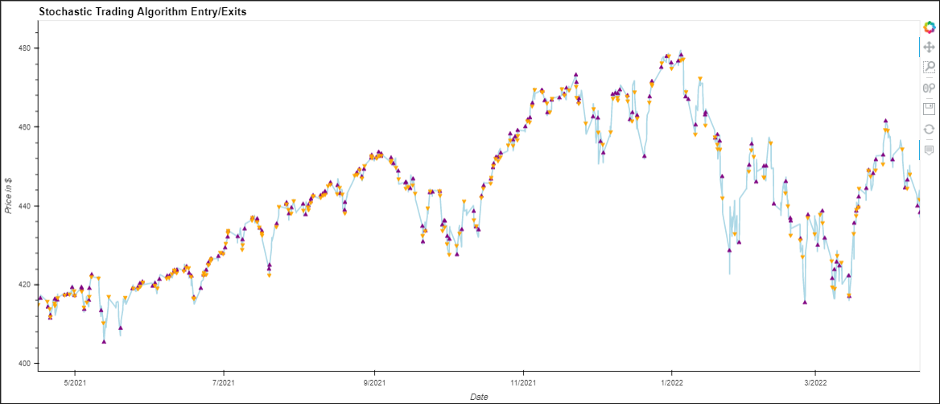
Technical Indicator Graphs - Stochastic

Slide 14
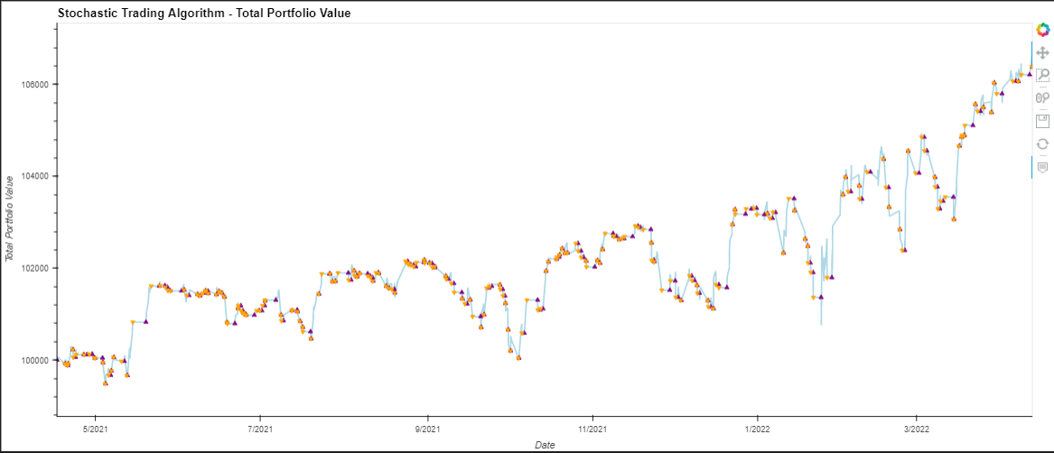
Technical Indicator Graphs - Stochastic

Slide 15
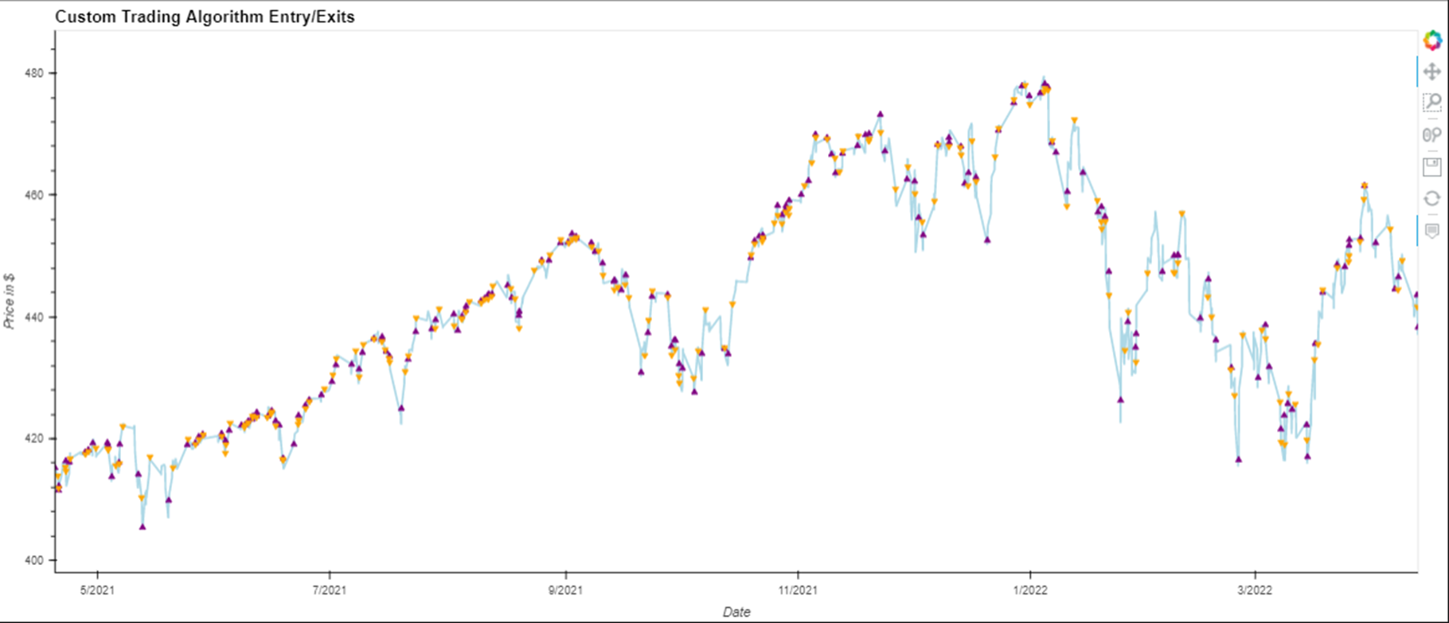
Technical Indicator Graphs - custom

Slide 16
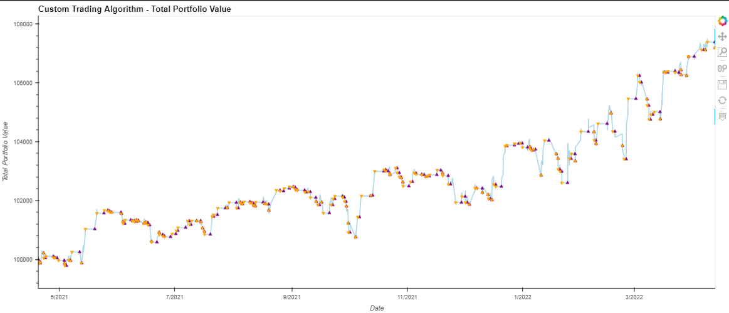
Technical Indicator Graphs - custom

Slide 17
Results for Technical Indicators *Based on data pulled on 4/13/2022
 | MACD | RSI | Stochastic | Custom (MACD/ Stochastic) | MACD Alt Signal | Custom MACD*/Stoch) | S&P 500
Value Counts | 1606 hold 68 buy 68 sell | 1745 hold 8 buy 8 sell | 1327 hold 209 buy 208 sell | 1486 hold 128 buy 128 sell | 1349 hold 197 buy 196 sell | 1486 hold 128 buy 128 sell | n/a
Win/Loss Rate | (26/42) 38.24% | (5/3) 62.50% | (88/120) 42.3% | (60/68) 46.88% | (81/115) 41.33% | (71/109) 39.44% | n/a
Profit | $2,223 | $2,388 | $6,380 | $4,260 | $7,759 | $7,189 | $7330
Return | 2.23% | 2.38% | 6.3% | 4.28% | 7.76% | 7.19% | 7.33%
Volatility | 4.33% | 5.86% | 4.59% | 3.28% | 4.37% | 3.98% | 1.53%
Sharpe Ratio | .5357 | .4327 | .521 | .4924 | 1.75 | .676 | .479

Slide 18
Overview: Machine Learning & Neural Network
Tried Logistic Regression
issues with due to multi-class classification
Model struggled because we have three classes [-1,0,1], rather than two classes [0,1] (binary_classification)
Tried Random Forest Classification
General issues with Logistic Regression & Random Forest Classification
Experienced issues due to imbalanced datasets - specifically within the signals
Limited by number of signals compared to neural network
Tried oversampling, but using RandomOverSampler didn't seem to help the classification report or confusion matrix results
For the neural network we used OneHotEncoder to help our model with understanding multi-class classification
OneHotEncoder makes all the categorical features into numerical arrays which improves performance of our ML model
We chose softmax which is specially designed for multi-class classification tasks (Instead of sigmoid option)
Used keras.metrics.CategoricalAccuracy() for measuring the accuracy metric since it calculates how often predictions match one-hot labels
Used CategoricalCrossentropy: Computes the cross-entropy loss between the labels and predictions

Slide 19
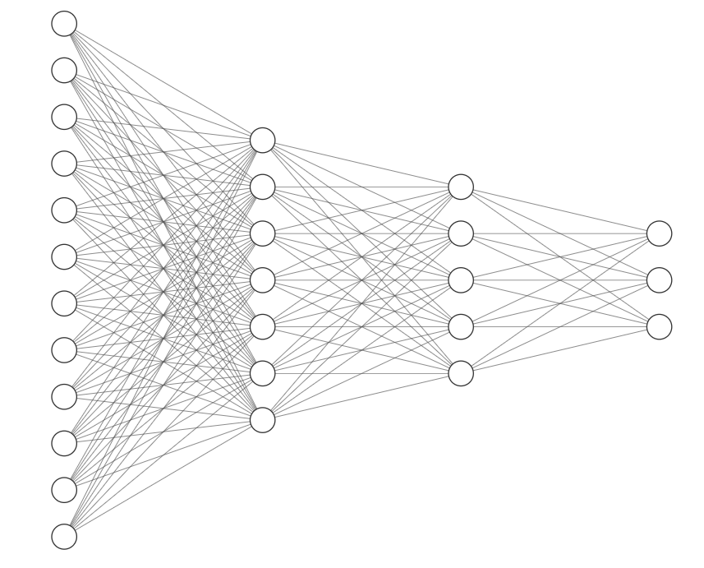
Neural Network Analysis (MACD model)
Output Layer Activation Function: Softmax
Hidden Layer Activation Functions: Relu
Epochs: 100
Loss function: keras.CategoricalCrossentropy()
Metric: keras.metrics.CategoricalAccuracy()
Training data: 3 months
Test data: 9 months
Loss: 0.13346697390079498
Accuracy 0.9592307806015015
Input Layer
12
Hidden Layer 1
7
Hidden Layer 2
5
Output Layer
3
Visualization built with
http://alexlenail.me/NN-SVG/index.html

Slide 20
Bitcoin Test
Can a model trained and tested on equities data be re-used for crypto data?
Used Bitcoin data to test the MACD model trained on SPY data
Bitcoin Data: 252 trading days; hourly data; pulled via API from Yahoo Finance
 | MACD Signal (Using BTC data) | Custom Signal (Using BTC data) | BTC Market
Value Counts | 6293 hold 1097 buy 1096 sell | 7141 hold 673 buy 672 sell | NA
Win/Loss Rate | (380/716) 34.67% | (239/433) 35.56% | NA
Profit | -$25,419 | -$20,152 | NA
Return | -25.4% | -20.1% | -36.4%
Volatility | 12.97% | 8.9% | 34%
Sharpe Ratio | -.4030 | -.1800 | .105

Slide 21
Conclusions and Next Steps
Based on these results, we determined:
Can outperform a a buy and hold strategy using technical trading – as seen by revised MACD model and custom model
Answering our research questions:
What technical indicators create the most consistent profit trading?
MACD and our custom model (combination of MACD and Stochastic)
How can machine learning improve the models and which model is best?
Additional data helps with analysis; Neural Network using OneHotEncoder performed best
Can an algorithm trained and tested on equities data be re-used for crypto data?
Yes – can smooth out variability and outperform in a bear market
To continue to improve this analysis, we propose to improve algorithms by:
Allowing longs and shorts
Using risk management strategies to include ‘stop loss’ and ‘take profits’
Apply the neural network output to the algorithm for Bitcoin data

